Slide 1
Level 1 Chapter 2: Core Azure Data Services

Slide 2
Overview of Azure SQL Database
Azure SQL is a cloud database offering that Microsoft provides as part of the Azure cloud computing platform.
Unlike other editions of SQL Server, you do not need to provision hardware for, install or patch Azure SQL; Microsoft maintains the platform for you.
You also do not need to architect a database installation for scalability, high availability, or disaster recovery as these features are provided automatically by the service.
Any application that uses Azure SQL must have Internet access in order to connect to the database.

Slide 3
Overview of Azure SQL Database
Since 2008, SQL Server and Azure SQL have both evolved to become more available, scalable, and performant to meet the demands of any application.
The database services offered have expanded from SQL Server to include open-source databases like Azure Database for PostgreSQL and Azure Database for MariaDB.

Slide 4
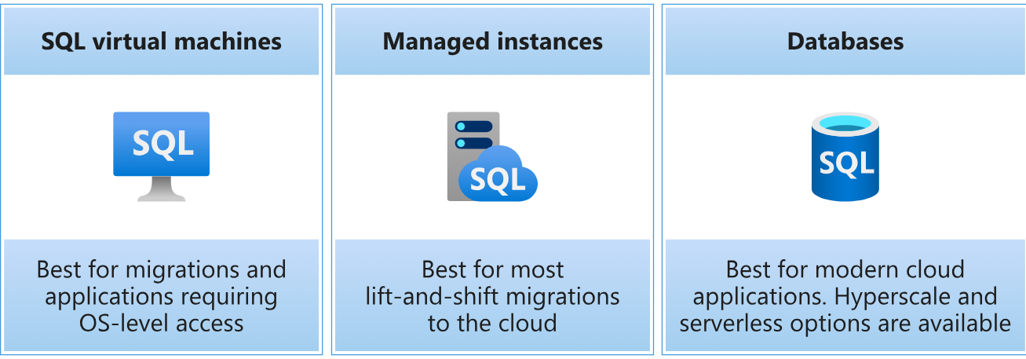
Overview of Azure SQL Database
Within the umbrella of the Azure SQL platform, there are many deployment options and choices that you can make.

Slide 5
SQL Server on Azure Virtual Machines
SQL Server on a virtual machine (VM) is a version of SQL Server that runs in an Azure VM. It's just SQL Server, so all your SQL Server skills should directly transfer, though Azure can help automate backups and security patches. SQL Server on an Azure VM is referred to as infrastructure as a service (IaaS). You're responsible for updating and patching the OS and SQL Server, apart from critical SQL Server security patches, but you have access to the full capabilities of SQL Server.
Here are some considerations for optimally deploying and managing SQL Server on VMs:
Deploy specific SQL Server and operating-system versions from preinstalled Azure gallery images. If you self-install SQL Server on an Azure VM, you can take advantage of the SQL Server IaaS Agent Extension for licensing flexibility and to enable automatic backups and updates.
Consider memory-optimized or storage-optimized VM sizes for maximum performance.
Use the right storage configuration and take advantage of Azure Blob storage read caching.
Integrate your VMs into on-premises networks by using Azure virtual networks.
Take advantage of automated backups, backups to Azure Blob storage, and integration with Azure Backup.
Always On Failover Cluster Instances is supported with Azure premium file share.
Always On availability groups are supported, including Cloud Witness.

Slide 6
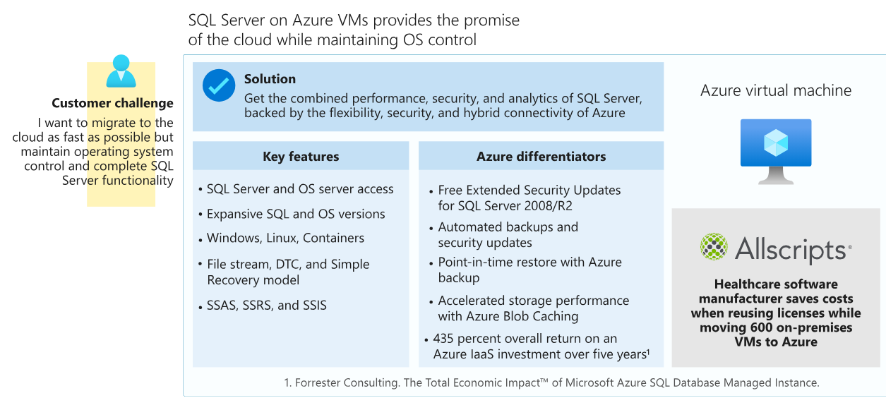
SQL Server on Azure Virtual Machines

Slide 7
SQL Managed Instance
SQL Managed Instance is a PaaS deployment option of Azure SQL. It gives you an instance of SQL Server, but removes much of the overhead of managing a VM. Most of the features available in SQL Server are available in SQL Managed Instance. This option is ideal for customers who want to use instance-scoped features and want to move to Azure without rearchitecting their applications. Instance-scoped features are tied to an instance of SQL Server, as opposed to features that are tied to a database in an instance of SQL Server.
Instance-scoped features of SQL Managed Instance include SQL Server Agent, Service Broker, common language runtime (CLR), Database Mail, linked servers, distributed transactions (preview), and Machine Learning Services. SQL Managed Instance allows you to access instance-scoped features, but you don't have to worry about, nor do you have access to, the OS or the infrastructure underneath.

Slide 8
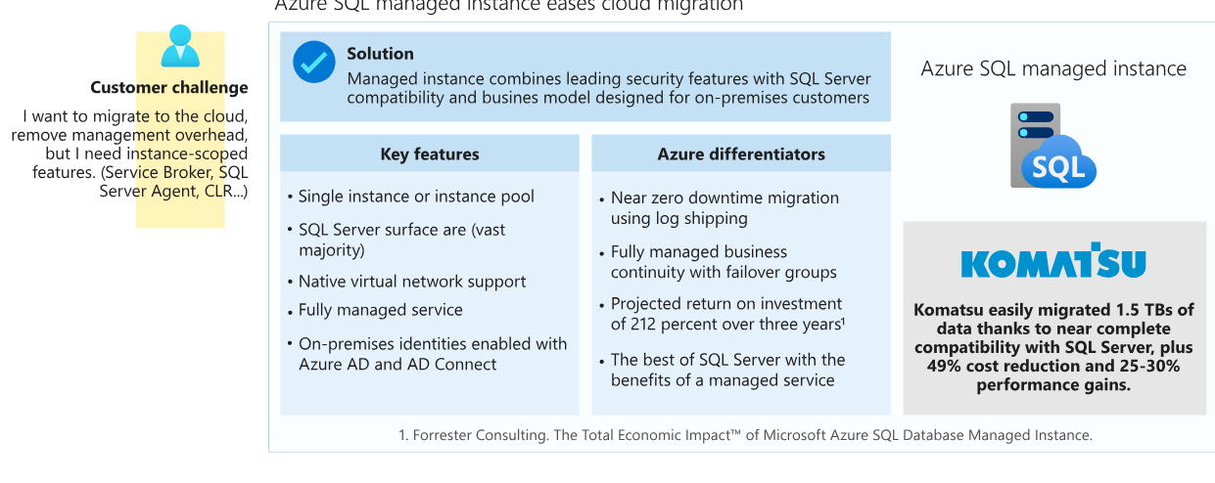
SQL Managed Instance

Slide 9
SQL Database
SQL Database is a PaaS deployment option of Azure SQL that abstracts both the OS and the SQL Server instance away from users. This deployment option allows you to just get a database and start developing applications. SQL Database is also the only deployment option that supports scenarios that require unlimited database storage (hyperscale) and autoscaling for unpredictable workloads (serverless). SQL Database has the industry's highest availability SLA. It provides other intelligent capabilities related to monitoring and performance, partly because Microsoft manages instances.

Slide 10
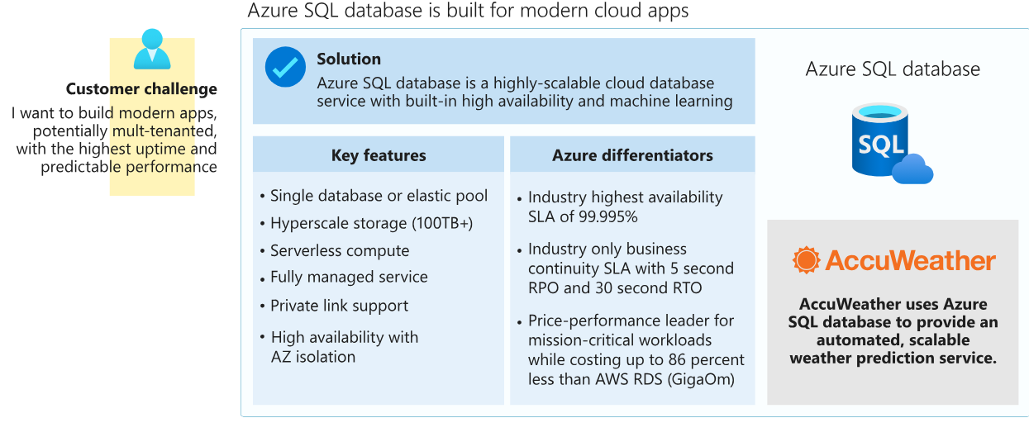
SQL Database

Slide 11
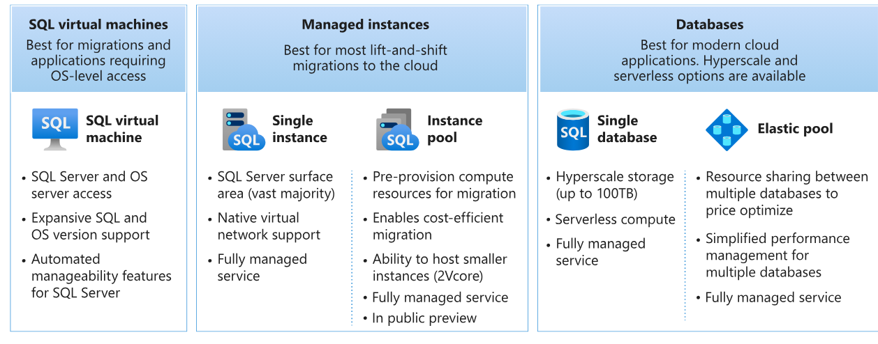
Azure SQL deployment options

Slide 12
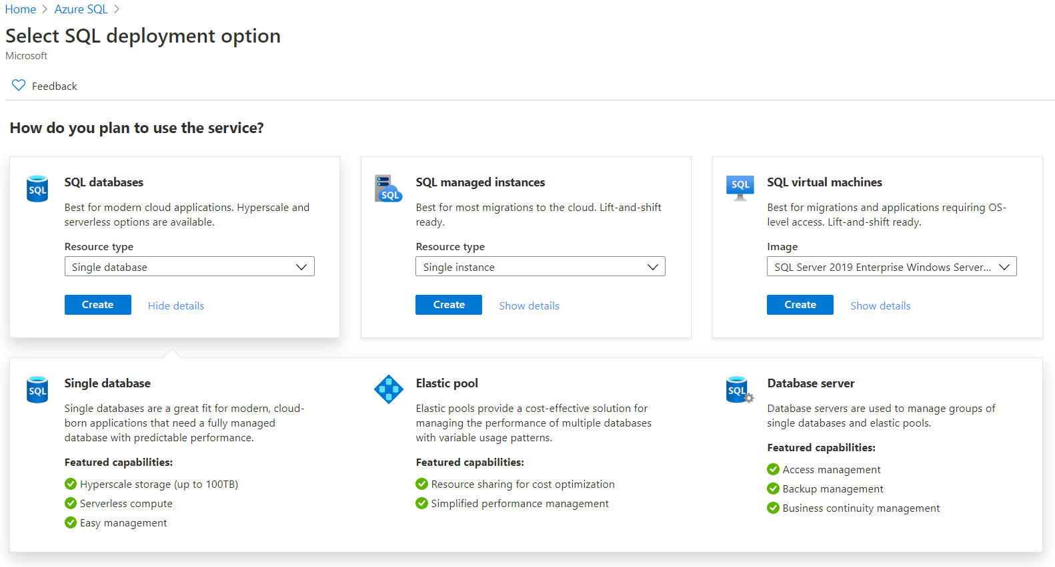
Management interfaces for Azure SQL: Azure Portal

Slide 13
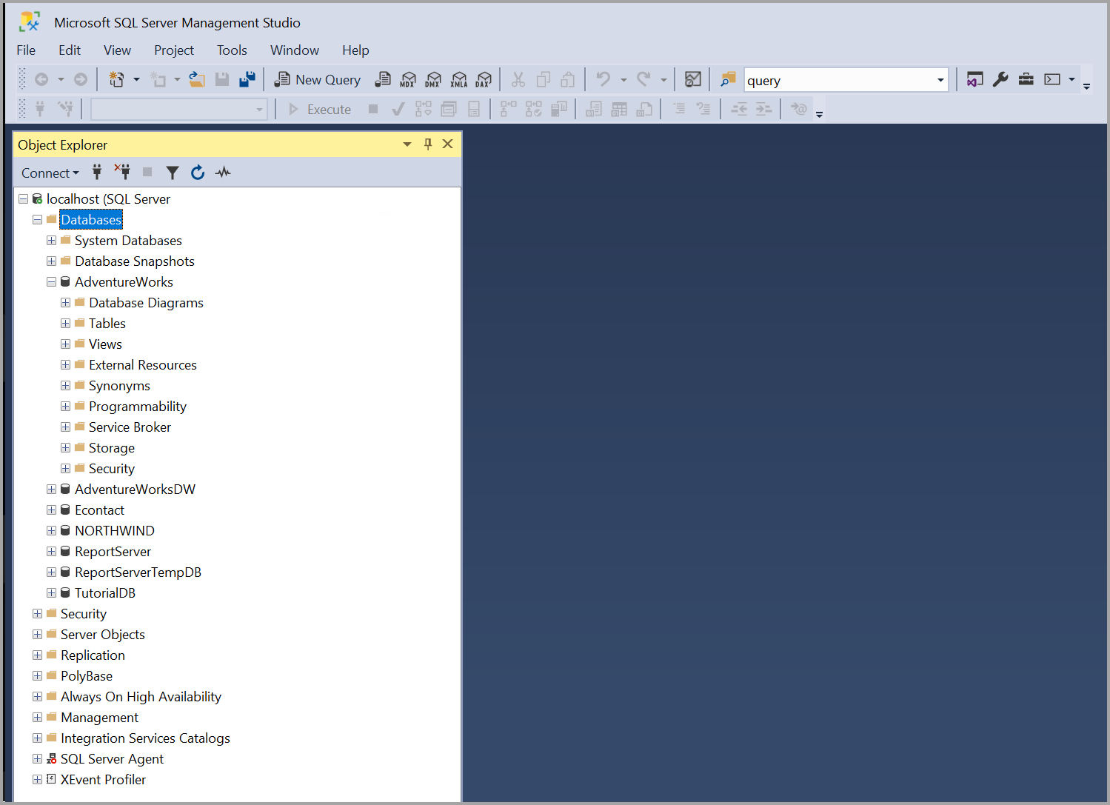
Management interfaces for Azure SQL: SQL Server Management Studio

Slide 14
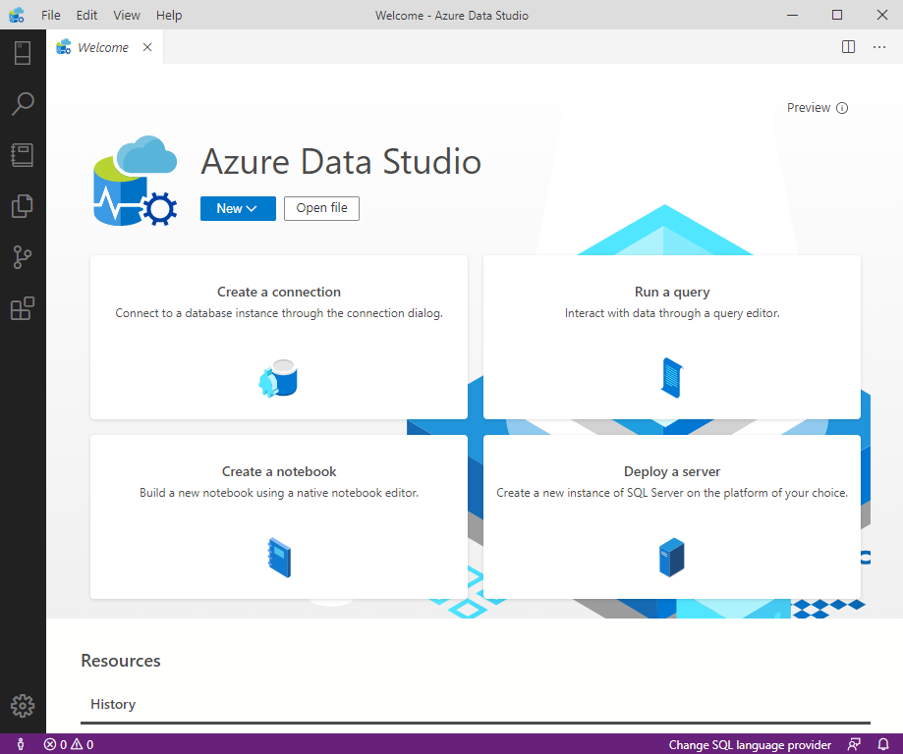
Management interfaces for Azure SQL: Azure Data Studio

Slide 15
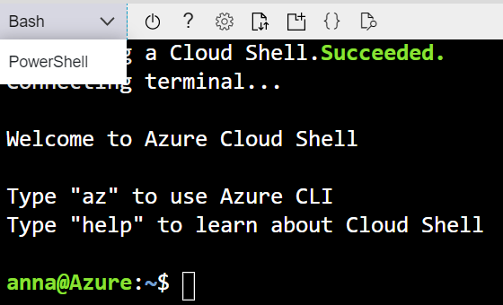
Management interfaces for Azure SQL: Languages and APIs, Command-line interfaces

Slide 16
Azure Cosmos DB
Relational databases store data in relational tables, but sometimes the structure imposed by this model can be too rigid, and often leads to poor performance unless you spend time implementing detailed tuning.
Other models, collectively known as NoSQL databases, exist.
These models store data in other structures, such as documents, graphs, key-value stores, and column family stores.
Azure Cosmos DB is a highly scalable cloud database service for NoSQL data.

Slide 17
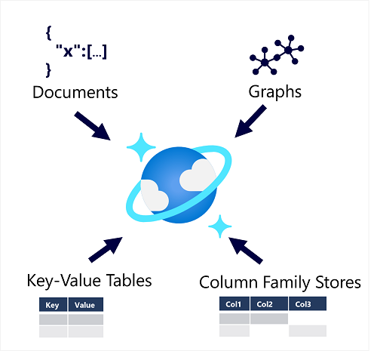
Azure Cosmos DB
Azure Cosmos DB supports multiple application programming interfaces (APIs) that enable developers to use the programming semantics of many common kinds of data store to work with data in a Cosmos DB database. The internal data structure is abstracted, enabling developers to use Cosmos DB to store and query data using APIs with which they're already familiar.

Slide 18
When to use Cosmos DB
Cosmos DB is a highly scalable database management system. Cosmos DB automatically allocates space in a container for your partitions, and each partition can grow up to 10 GB in size. Indexes are created and maintained automatically. There's virtually no administrative overhead.
Cosmos DB is a foundational service in Azure. Cosmos DB has been used by many of Microsoft's products for mission critical applications at global scale, including Skype, Xbox, Microsoft 365, Azure, and many others. Cosmos DB is highly suitable for the following scenarios:
IoT and telematics. These systems typically ingest large amounts of data in frequent bursts of activity. Cosmos DB can accept and store this information quickly. The data can then be used by analytics services, such as Azure Machine Learning, Azure HDInsight, and Power BI. Additionally, you can process the data in real-time using Azure Functions that are triggered as data arrives in the database.

Slide 19
When to use Cosmos DB
Retail and marketing. Microsoft uses Cosmos DB for its own e-commerce platforms that run as part of Windows Store and Xbox Live. It's also used in the retail industry for storing catalog data and for event sourcing in order processing pipelines.
Gaming. The database tier is a crucial component of gaming applications. Modern games perform graphical processing on mobile/console clients, but rely on the cloud to deliver customized and personalized content like in-game stats, social media integration, and high-score leaderboards. Games often require single-millisecond latencies for reads and write to provide an engaging in-game experience. A game database needs to be fast and be able to handle massive spikes in request rates during new game launches and feature updates.
Web and mobile applications. Azure Cosmos DB is commonly used within web and mobile applications, and is well suited for modeling social interactions, integrating with third-party services, and for building rich personalized experiences. The Cosmos DB SDKs can be used to build rich iOS and Android applications using the popular Xamarin framework.

Slide 20
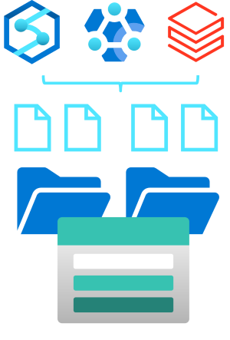
Understand Azure Data Lake Storage Gen2
A data lake is a repository of data that is stored in its natural format, usually as blobs or files. Azure Data Lake Storage is a comprehensive, massively scalable, secure, and cost-effective data lake solution for high performance analytics built into Azure.

Slide 21
Understand Azure Data Lake Storage Gen2
Benefits
Data Lake Storage is designed to deal with this variety and volume of data at exabyte scale while securely handling hundreds of gigabytes of throughput. With this, you can use Data Lake Storage Gen2 as the basis for both real-time and batch solutions.

Slide 22
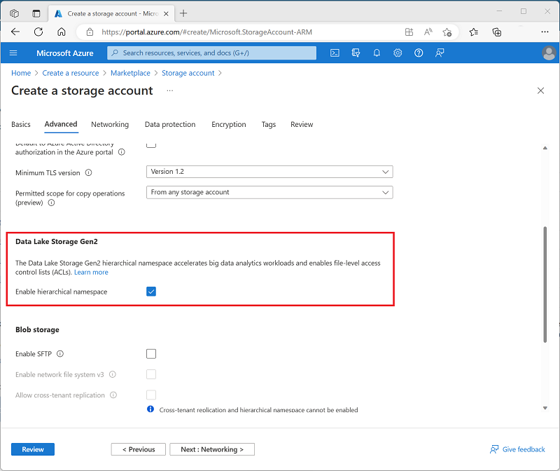
Enable Azure Data Lake Storage Gen2 in Azure Storage
Azure Data Lake Storage Gen2 isn't a standalone Azure service, but rather a configurable capability of a StorageV2 (General Purpose V2) Azure Storage.

Slide 23
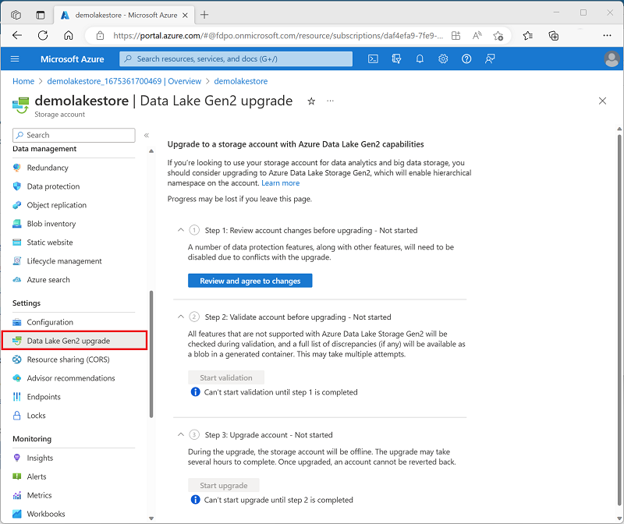
Enable Azure Data Lake Storage Gen2 in Azure Storage
Alternatively, if you already have an Azure Storage account and want to enable the Azure data Lake Storage Gen2 capability, you can use the Data Lake Gen2 upgrade wizard in the Azure portal page for your storage account resource.

Slide 24
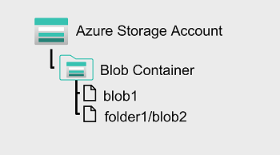
Compare Azure Data Lake Store to Azure Blob storage
In Azure Blob storage, you can store large amounts of unstructured ("object") data in a flat namespace within a blob container. Blob names can include "/" characters to organize blobs into virtual "folders", but in terms of blob manageability the blobs are stored as a single-level hierarchy in a flat namespace.

Slide 25
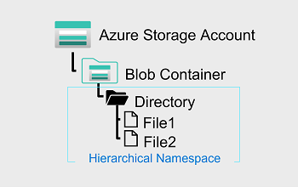
Compare Azure Data Lake Store to Azure Blob storage
Azure Data Lake Storage Gen2 builds on blob storage and optimizes I/O of high-volume data by using a hierarchical namespace that organizes blob data into directories, and stores metadata about each directory and the files within it.
This structure allows operations, such as directory renames and deletes, to be performed in a single atomic operation.
Flat namespaces, by contrast, require several operations proportionate to the number of objects in the structure. Hierarchical namespaces keep the data organized, which yields better storage and retrieval performance for an analytical use case and lowers the cost of analysis.

Slide 26
Compare Azure Data Lake Store to Azure Blob storage
Tip
If you want to store data without performing analysis on the data, set the Hierarchical Namespace option to Disabled to set up the storage account as an Azure Blob storage account. You can also use blob storage to archive rarely used data or to store website assets such as images and media.
If you are performing analytics on the data, set up the storage account as an Azure Data Lake Storage Gen2 account by setting the Hierarchical Namespace option to Enabled. Because Azure Data Lake Storage Gen2 is integrated into the Azure Storage platform, applications can use either the Blob APIs or the Azure Data Lake Storage Gen2 file system APIs to access data.

Slide 27
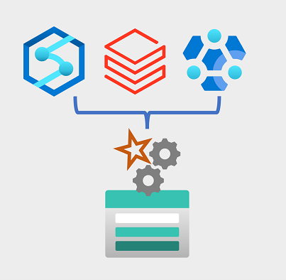
Use Azure Data Lake Storage Gen2 in data analytics workloads: Big data processing and analytics
Azure Data Lake Store Gen2 is an enabling technology for multiple data analytics use cases. Let's explore a few common types of analytical workload, and identify how Azure Data Lake Storage Gen2 works with other Azure services to support them.

Slide 28
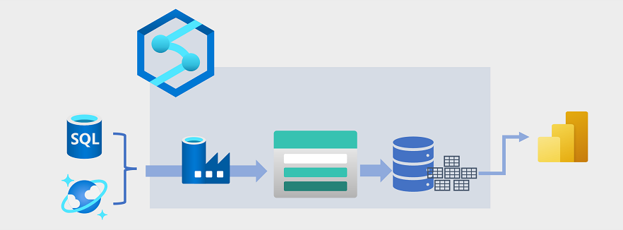
Use Azure Data Lake Storage Gen2 in data analytics workloads: Data warehousing
Data warehousing has evolved in recent years to integrate large volumes of data stored as files in a data lake with relational tables in a data warehouse. In a typical example of a data warehousing solution, data is extracted from operational data stores, such as Azure SQL database or Azure Cosmos DB, and transformed into structures more suitable for analytical workloads. Often, the data is staged in a data lake in order to facilitate distributed processing before being loaded into a relational data warehouse. In some cases, the data warehouse uses external tables to define a relational metadata layer over files in the data lake and create a hybrid "data lakehouse" or "lake database" architecture. The data warehouse can then support analytical queries for reporting and visualization.

Slide 29

Use Azure Data Lake Storage Gen2 in data analytics workloads: Real-time data analytics
Increasingly, businesses and other organizations need to capture and analyze perpetual streams of data, and analyze it in real-time (or as near to real-time as possible). These streams of data can be generated from connected devices (often referred to as internet-of-things or IoT devices) or from data generated by users in social media platforms or other applications. Unlike traditional batch processing workloads, streaming data requires a solution that can capture and process a boundless stream of data events as they occur.

Slide 30
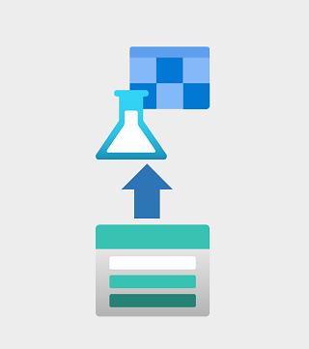
Use Azure Data Lake Storage Gen2 in data analytics workloads: Data science and machine learning
Data science involves the statistical analysis of large volumes of data, often using tools such as Apache Spark and scripting languages such as Python. Azure Data Lake Storage Gen 2 provides a highly scalable cloud-based data store for the volumes of data required in data science workloads.
Machine learning is a subarea of data science that deals with training predictive models. Model training requires huge amounts of data, and the ability to process that data efficiently. Azure Machine Learning is a cloud service in which data scientists can run Python code in notebooks using dynamically allocated distributed compute resources. The compute processes data in Azure Data Lake Storage Gen2 containers to train models, which can then be deployed as production web services to support predictive analytical workloads.

Slide 31
Thanking you !!!
Any Question !!!!

